Slide 1


BIT07 – Machine Learning
Cedric Hermans

Slide 2
Unbalanced data

Slide 3
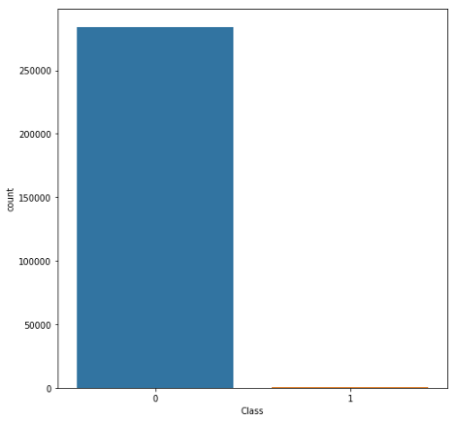
Unbalanced data
Data where classes are not equally distributed
E.g. bank transactions:
49 x not suspicious
1 x suspicious

Slide 4
Unbalanced data
Problem
When training, majority is of one class
Classifying everything as this class yields high accuracy
Accuracy = (699+2)/(699+1+73+2) = 90%
Recall:
P: 699/700 = 99,8%
N: 2,67%
 | P’ (Predicted) | n’ (Predicted)
P (Actual) | 699 | 1
N (Actual) | 73 | 2

Slide 5
Unbalanced data
Possible solutions
Hyperparameter tuning
Collect more data
Undersampling
Oversampling
Change scorer (default: accuracy)
Class-weight balancing
Data augmentation

Slide 6
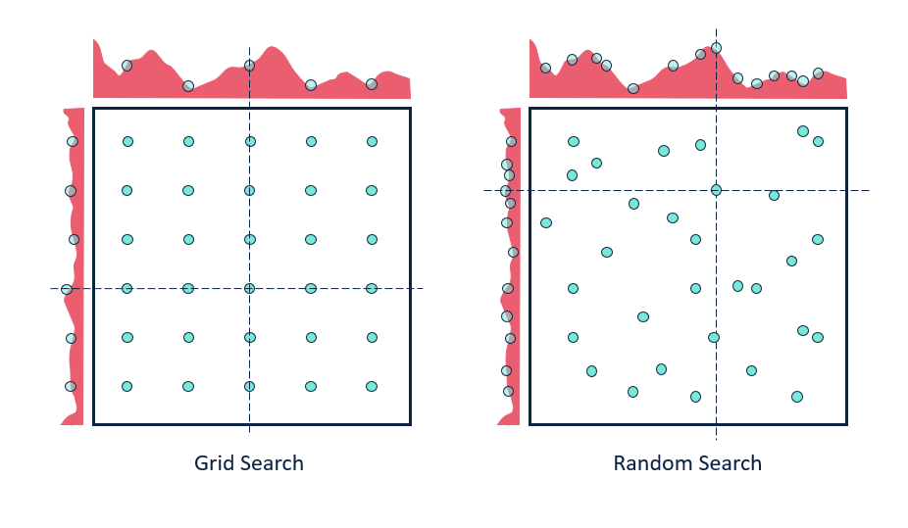
Hyperparameter tuning
See ppt 2.1
Not always effective with unbalanced data
When it works, might be overfitted to fit the minor class

Slide 7

Collect more data
More data -> better models
Add more samples of minority class

Slide 8
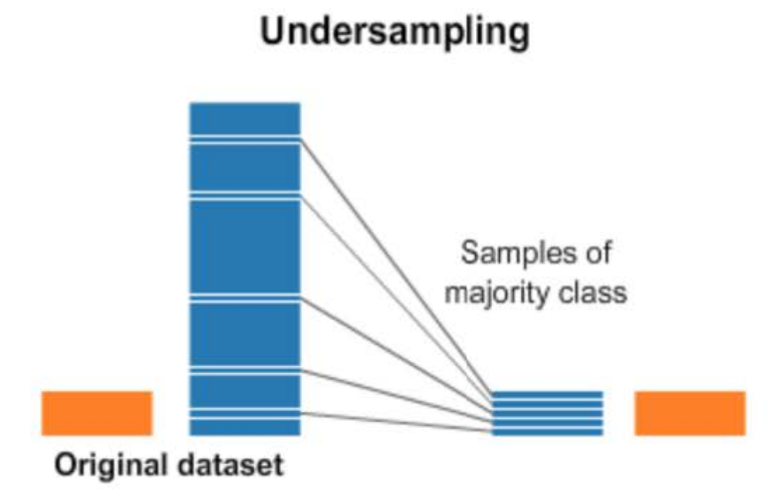
Undersampling
Take a subset of the majority class +- equal to the minority class as training data.
Disadvantage: you lose training data that could be used to improve your model
E.g.
Class 1: 700 samples
Class 2: 75 samples
=> Take only 75 samples of class 1

Slide 9
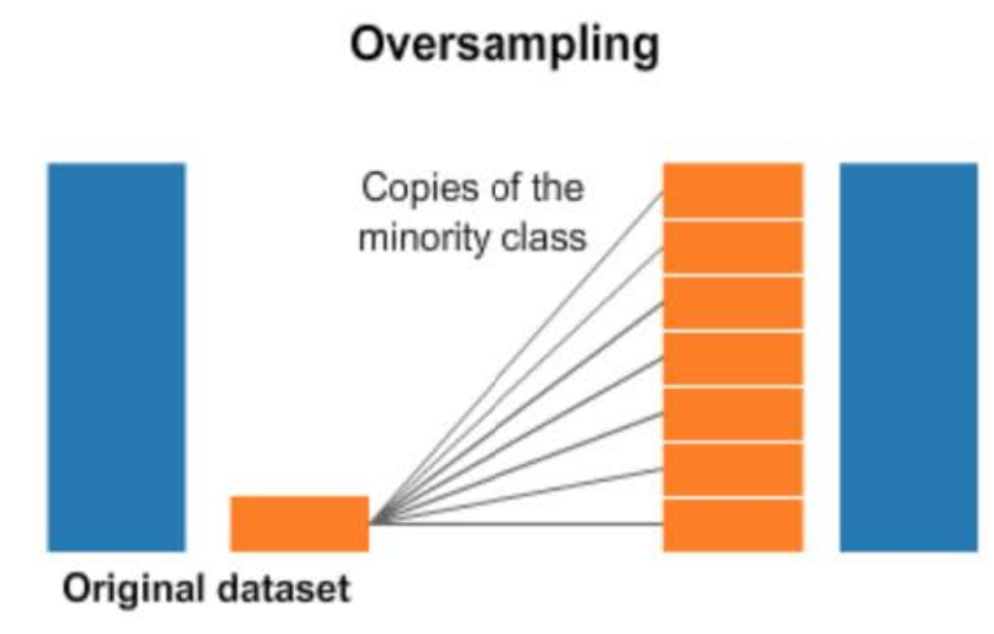
Oversampling
Copy the minority class multiple times in your dataset until you have +- the same number of samples as in the majority class.
Disadvantage: you could overfit the minority class, since there are few distinct points that indicate the class
E.g.
Class 1: 700 samples
Class 2: 75 samples
=> Add an additional 8 copies of class 2 to the training data => 675 samples

Slide 10
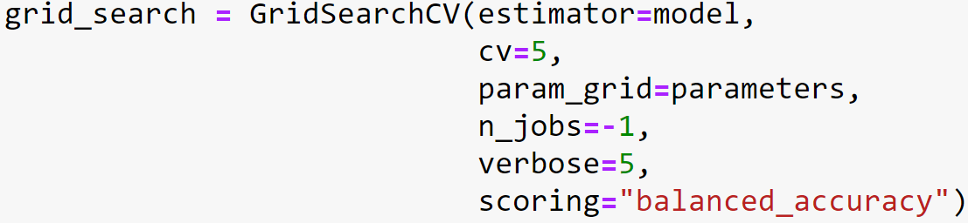
Change the scorer
Default scoring system: accuracy
Change it to another metric like
Recall
F1-score
balanced_accuracy (average of recalls)
More
Is a parameter that can be set in for example grid search/random search/bayes optimizer

Slide 11
Class-weight balancing
By default: error of both classes contributes equally to the scores
If you have a 10x difference between two classes e.g.,
Class 1 : 100 samples
Class 2 : 10 samples
Instead of taking them equally into account: punish wrong classification of class 2 harder (e.g., 10x as hard)

Slide 12
Class-weight balancing
Most models have a parameter “class_weight”
3 ways to specify for an unbalanced dataset:
Keyword: class_weight=“balanced” (automatically sets values based on count per class)
List: [1,9] (weight per class in same order as the classes in the dataset)
Dictionary: {“name_of_class1”:1, ”name_of_class2”:9}
model=LogisticRegression(class_weight=`value here`)

Slide 13
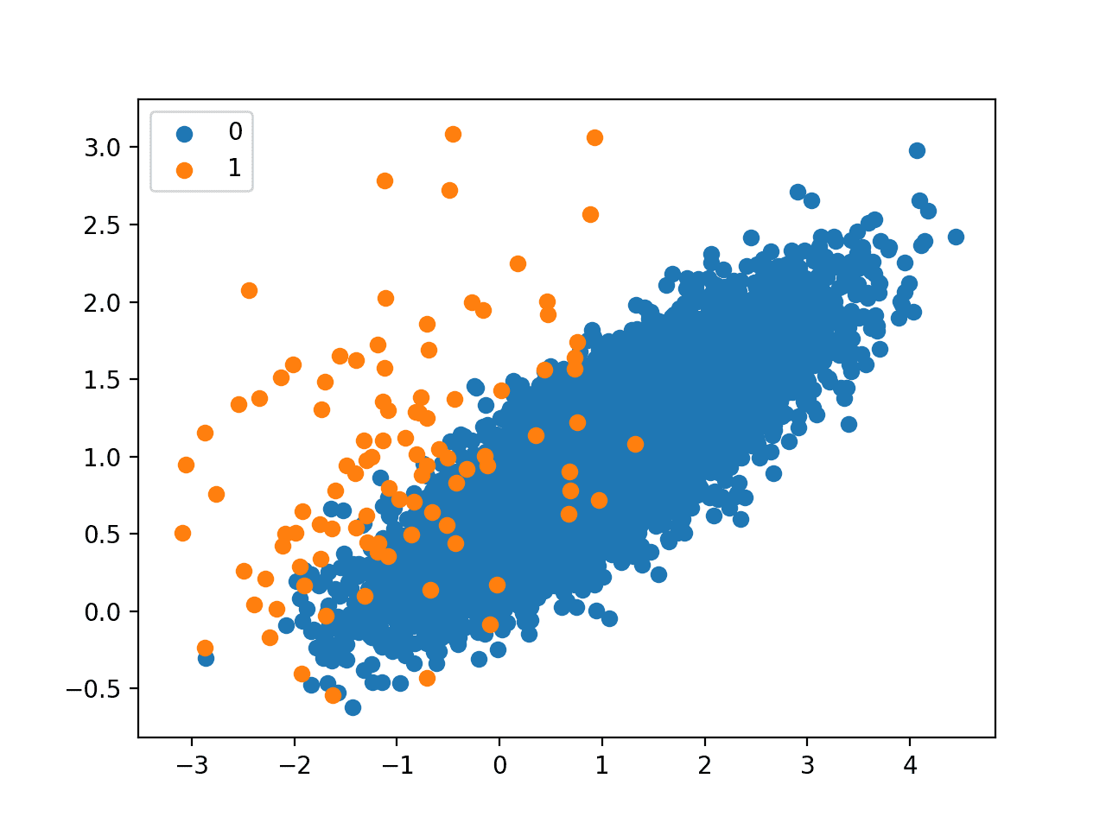
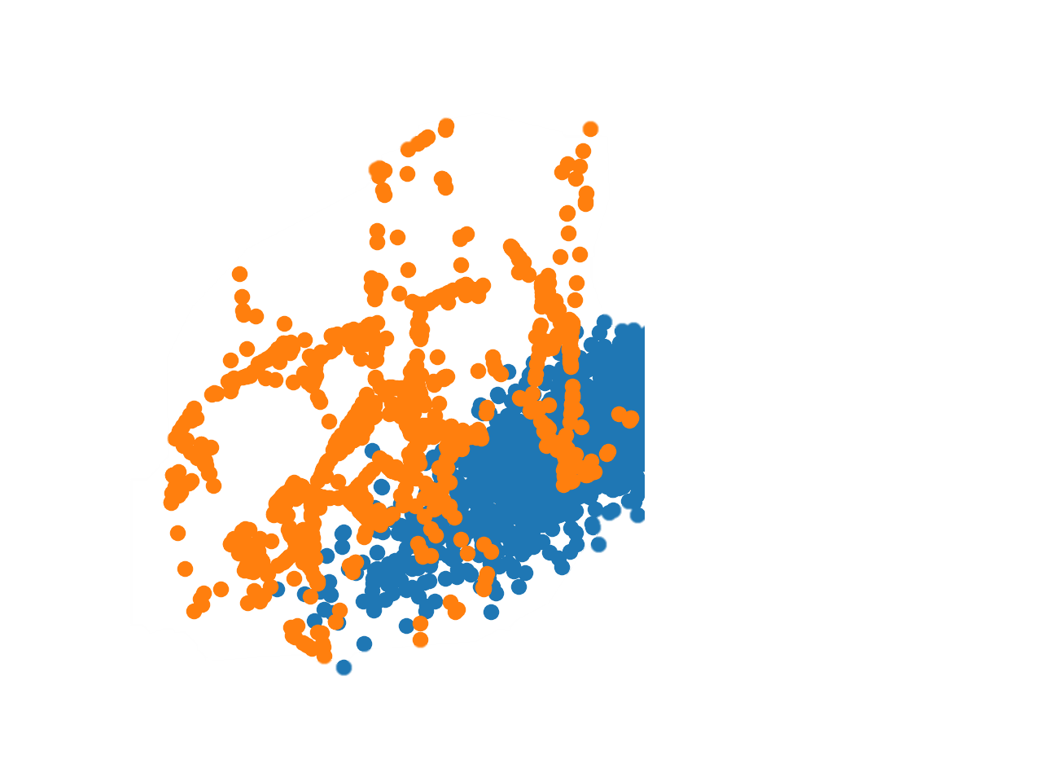
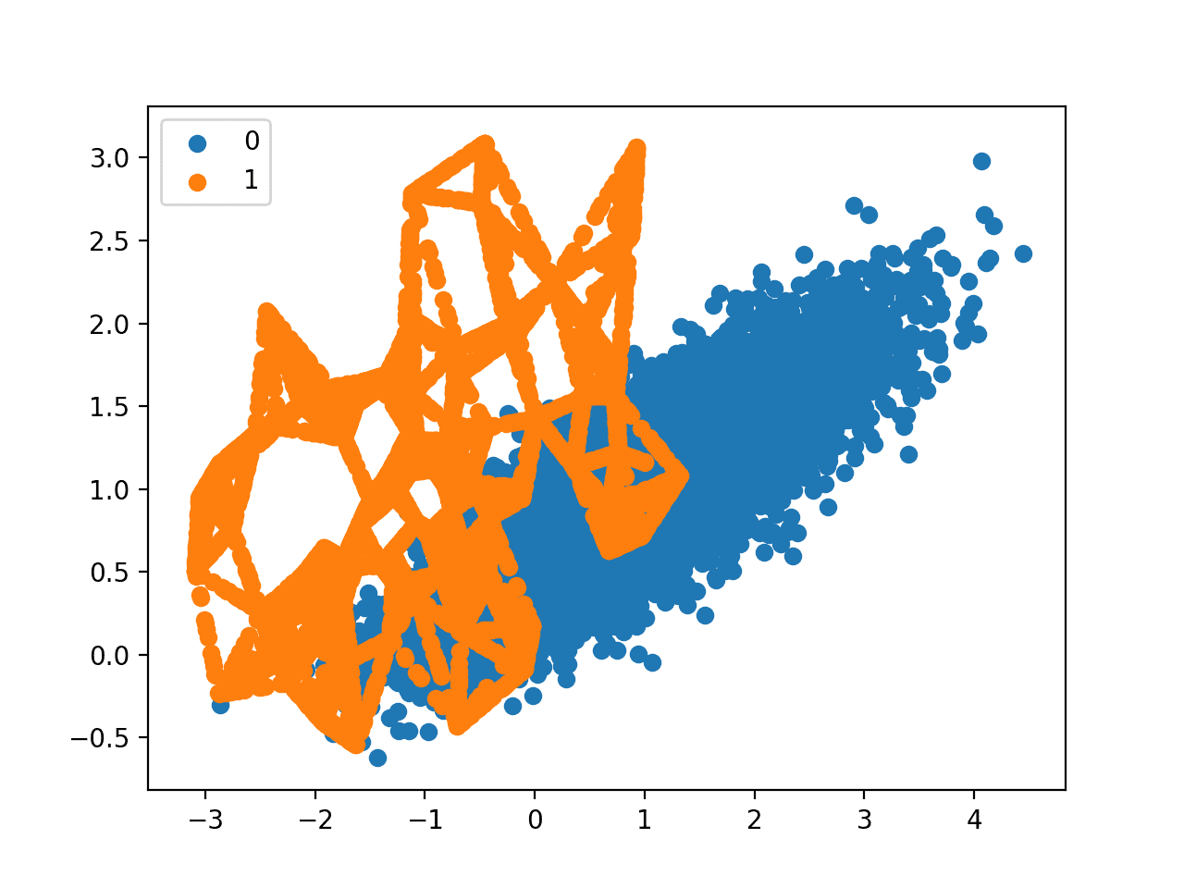
Data augmentation
“Impute” values for the minority class
Based on known values: calculate
other probable values for the class
Similar to oversampling, but values
are not exactly the same
Well known algorithms:
SMOTE, ADASYN

